Slide 1
Vegetation analysis of fire-affected region in the context of land management
By Brooke Hunter and Jon Sheppard

Slide 2
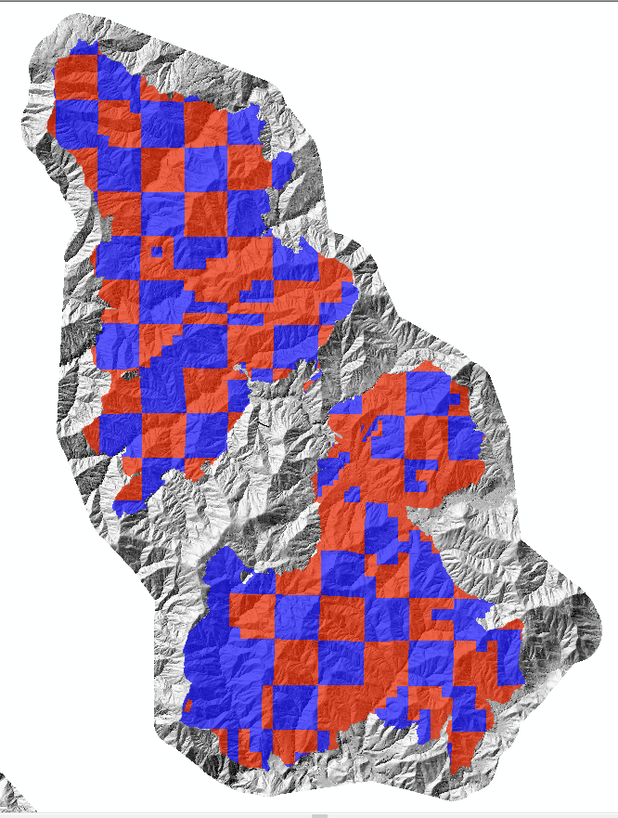
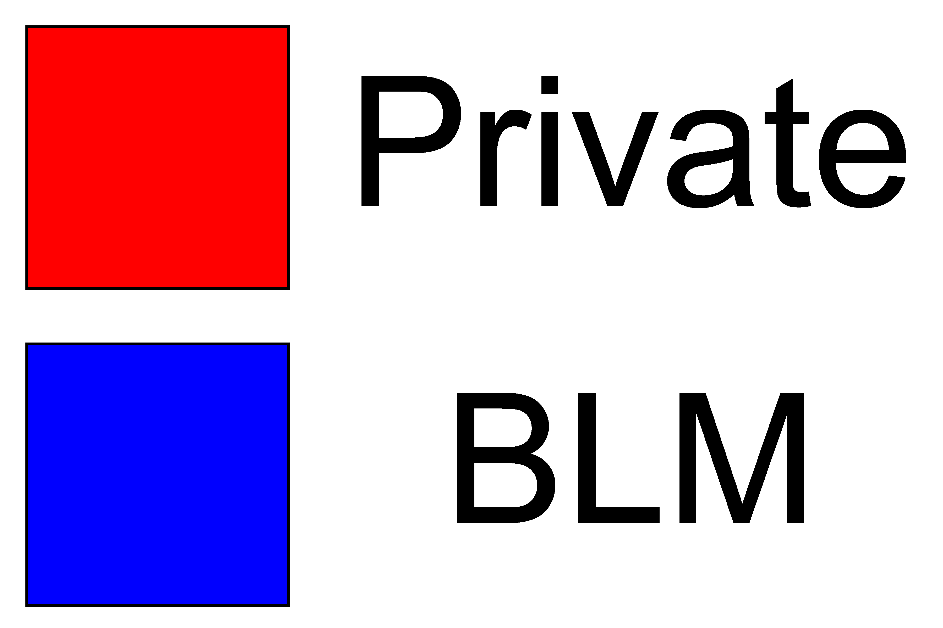
Motivation
Wildfire frequency and intensity has increased in recent years. In Oregon, a checkerboard of privately and publicly owned land has resulted in a landscape that has sharp boundaries between clear cut and vegetated regions. How does this pattern affect the long-term recovery of vegetation?
Notes:
Problem statement

Slide 3
Goals
our project we aim to investigate how this pattern of private and public land management influences vegetation recovery through normalized differenced vegetation index analysis (NDVI) over time pre and post-fire.
**Questions**
- How quickly does vegetation recover after wildfires?
- How does recovery vary based on land management practices?
**Objectives**
- We will use normalized differenced vegetation index (NDVI) to quantify vegetation recovery of the Douglas Fire region which occurred due to a lightning strike in July 2013.
- We will separate this analysis based on land ownership separate by private and publicly (Bureau of Land Management) land.

Slide 4
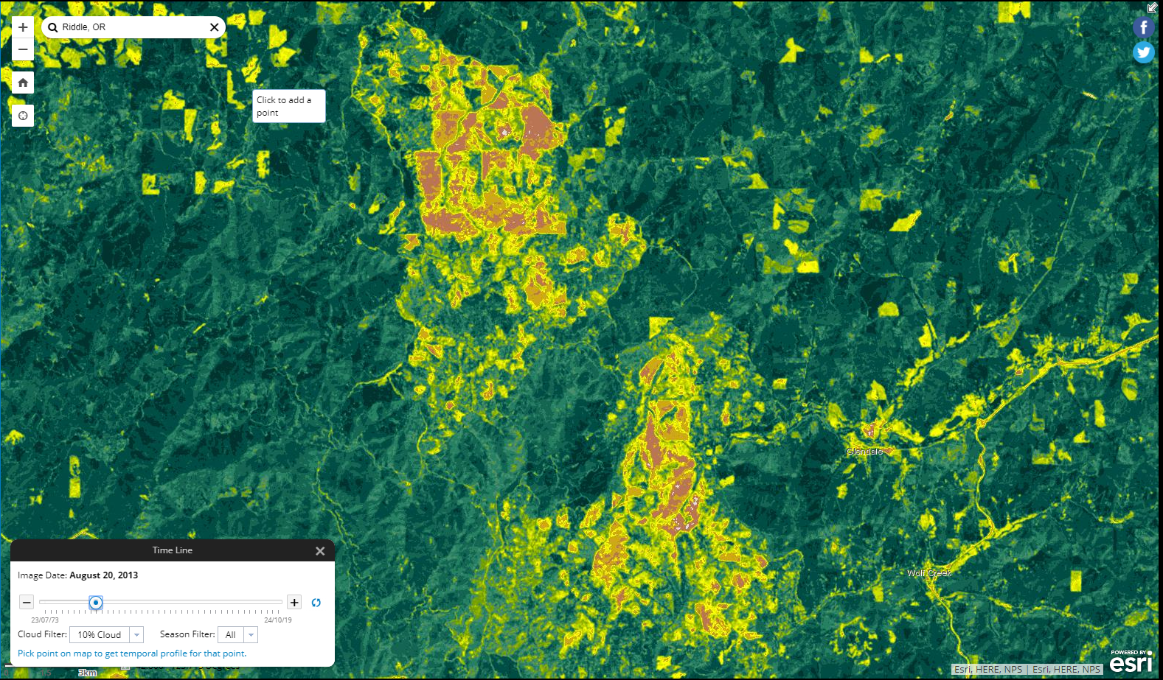
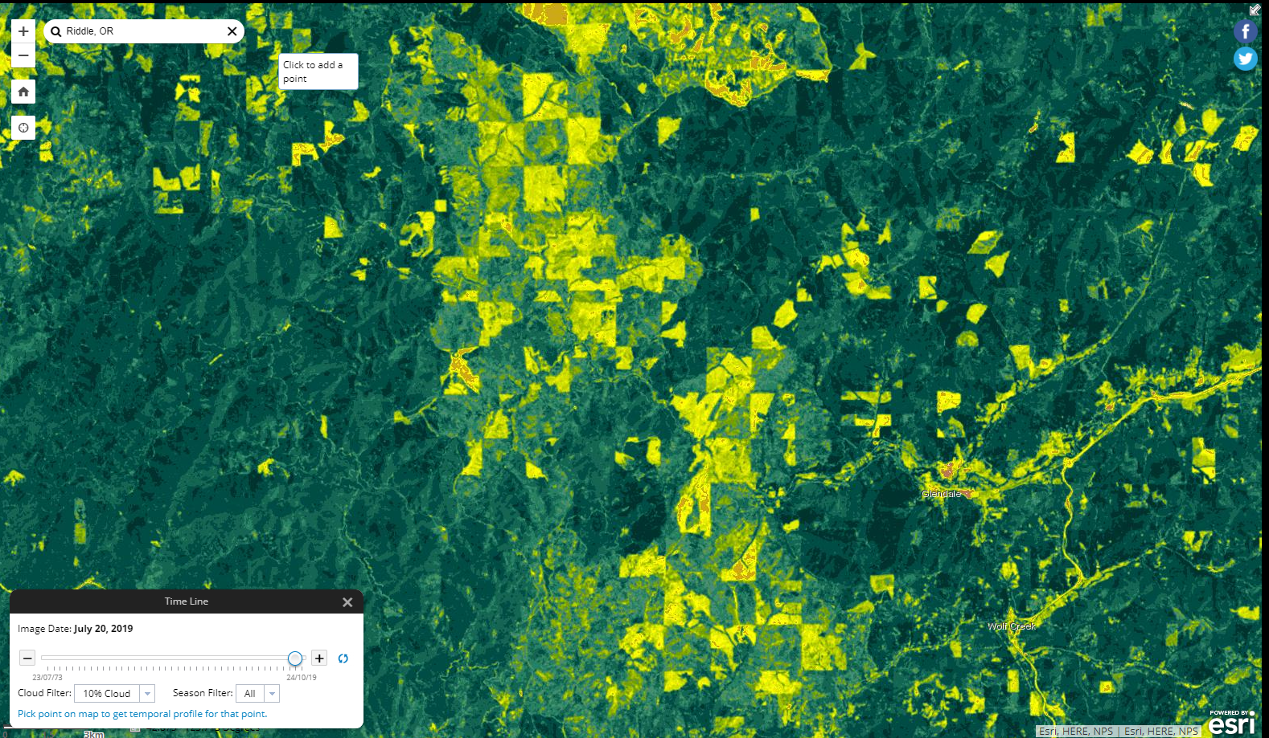
Douglas Fire Complex (2013)
August 20, 2013
July 20th, 2019

Slide 5
Methodology: Datasets
Landsat 7-8 imagery 2012-2022 (Google Earth Engine): 30% cloud cover. 99 images
Douglas Complex Fire (2013) .tif file
Land Status Oregon ownership (BLM arc services): 1 (white) = private, 0 (black) = BLM

Slide 6
Methodology: Tools
Google Earth Engine: Landsat images
gdal: convert Douglas fire extent .tif and land status .tif to match crs of Landsat images (ESPG: 32610) and pad their spatial extents to match Landsat images
Jupyter Lab: manipulation and analysis of data after downloading and using gdal from command line

Slide 7
Methodology: Workflow
Query Landsat Collection through Google Earth Engine via Google Collab.
Calculate Normalized Difference Vegetation Index (NDVI) of each image.
Convert Douglas Fire extent and ownership tifs to ESPG: 32610.
Pad Douglas Fire and ownership tifs to match Landsat spatial extent.
Subset and clip NDVI images based on Douglas Fire extent .tif file.
Subset newly clipped NDVI images based on a binary ownership file.
Analyze trends in the resulting data with boxplot and mean values.

Slide 8
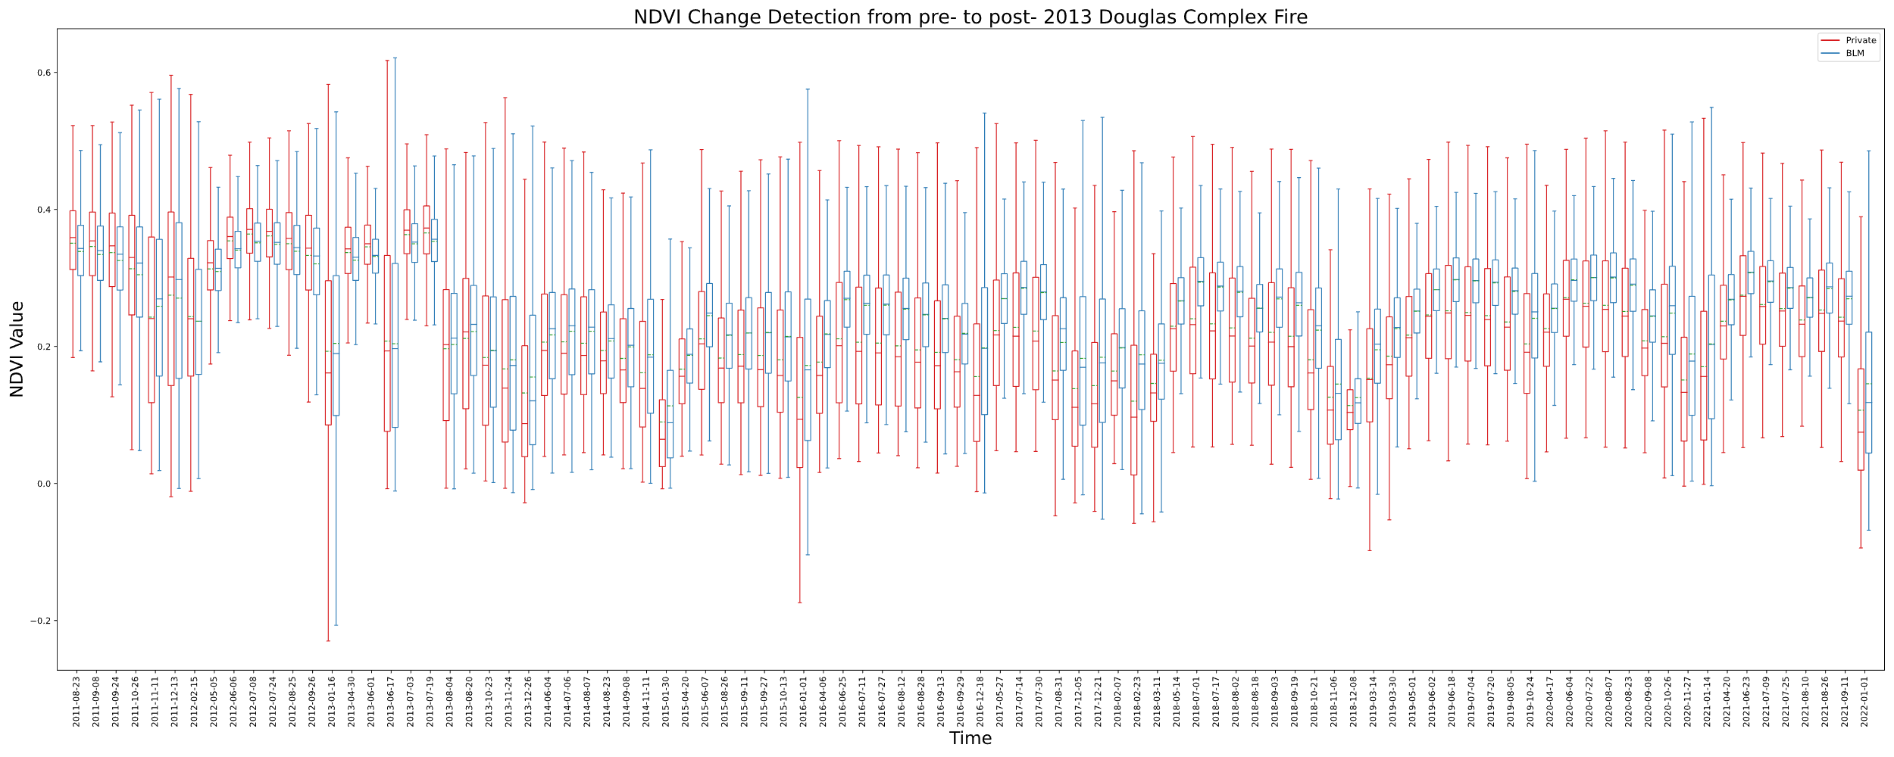
Results: Boxplots

Slide 9
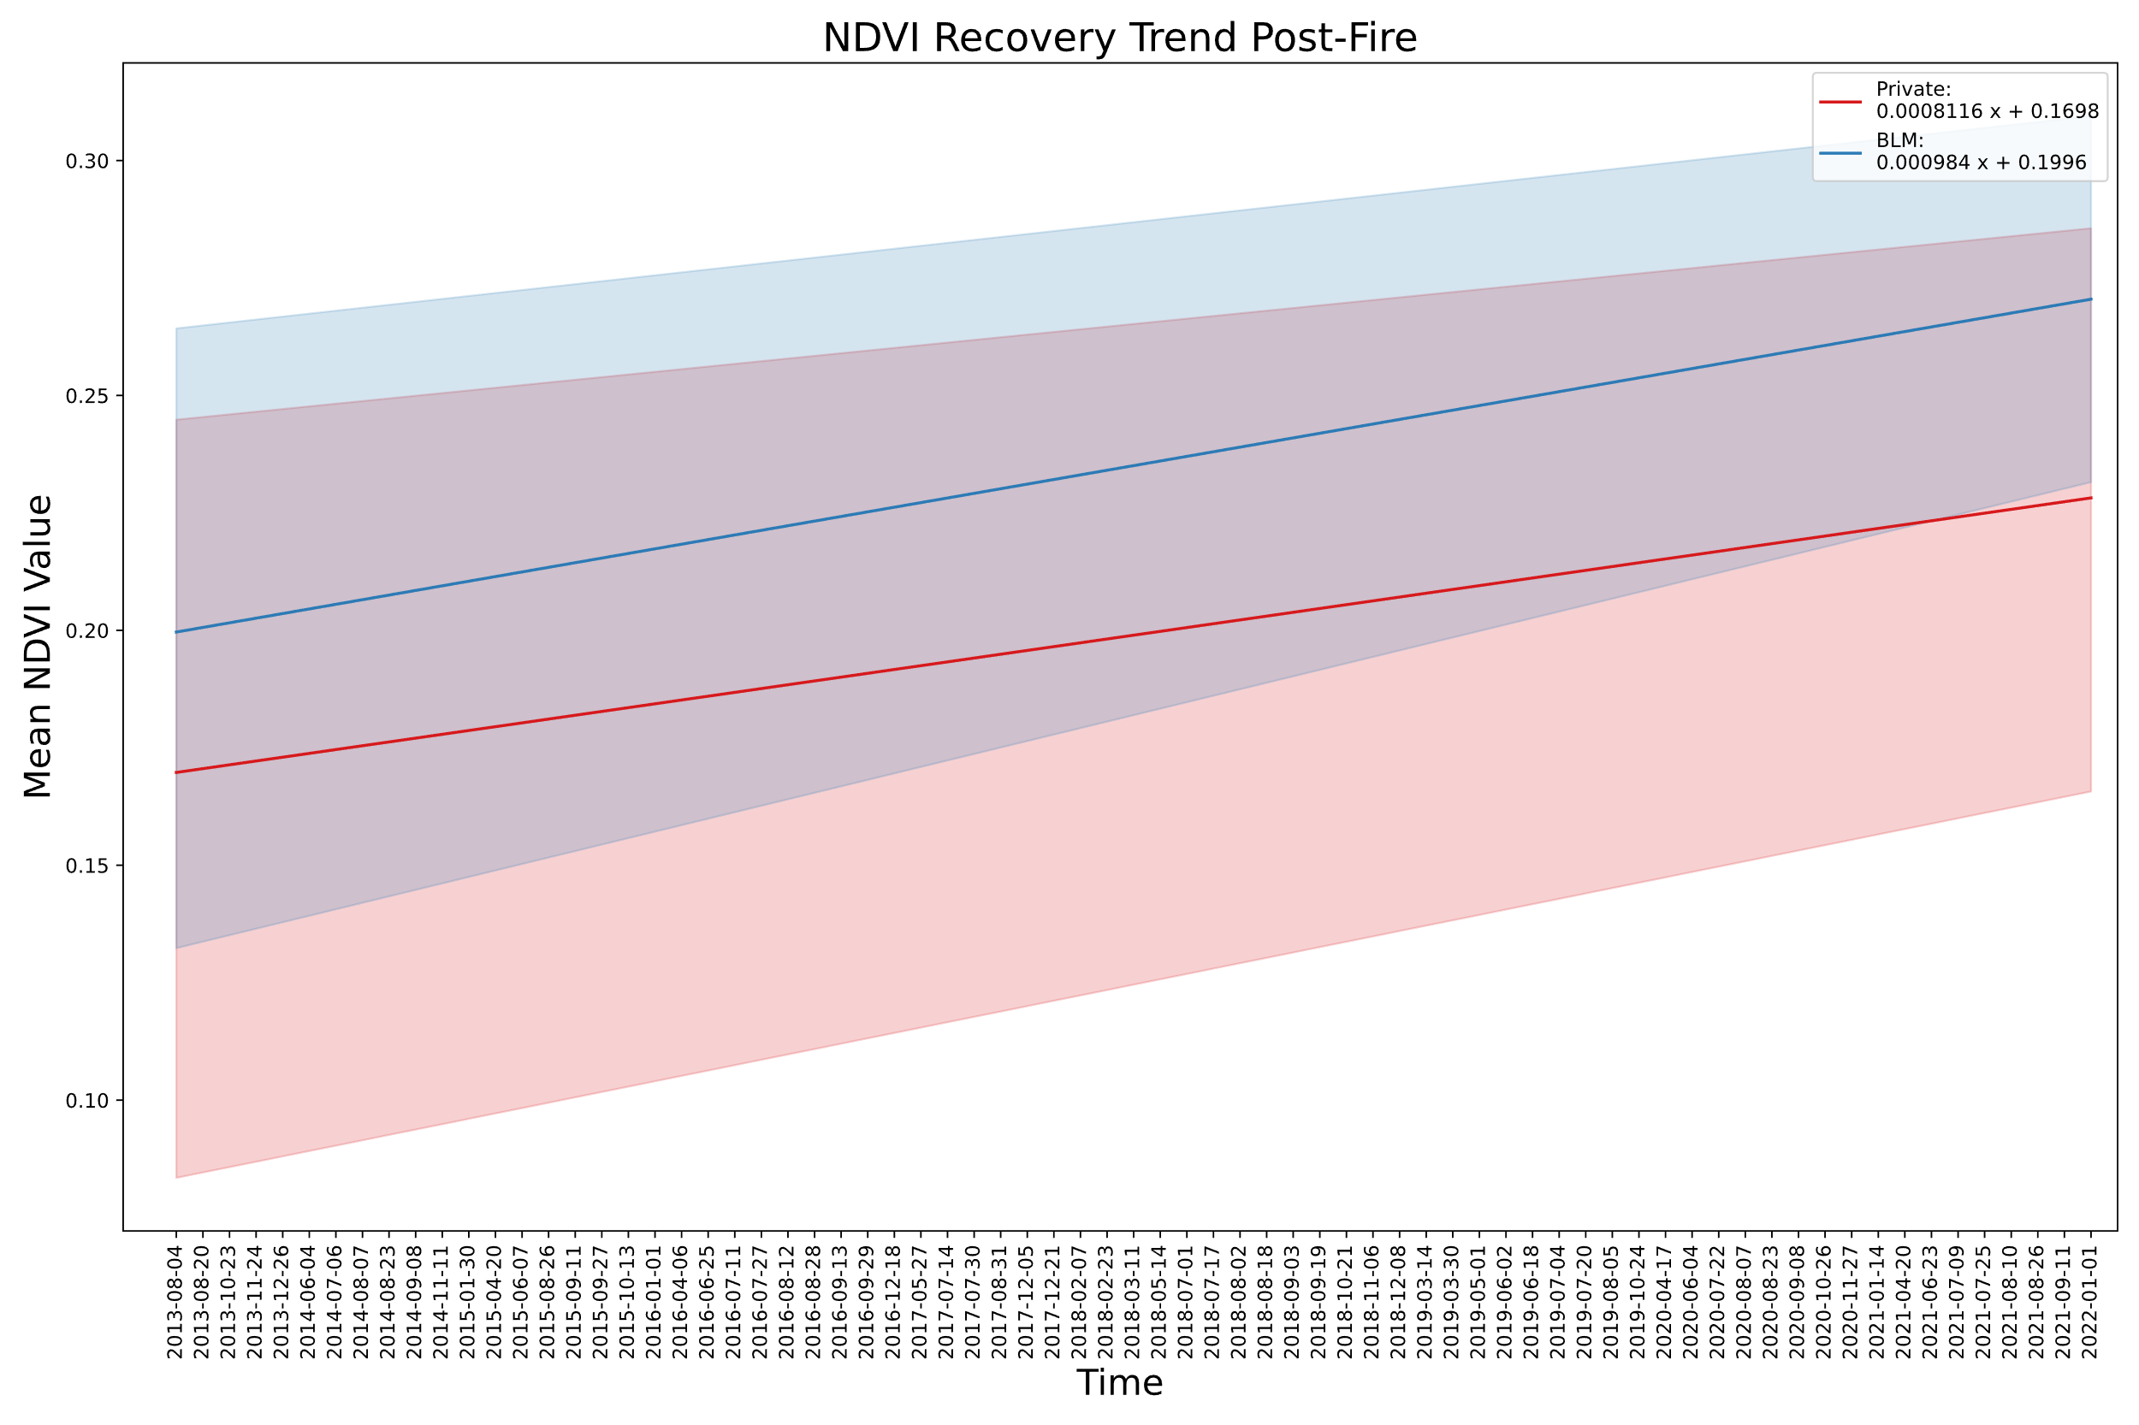
Results: Mean NDVI Trendlines

Slide 10
Discussion
Land managed by the BLM has a greater recovery rate, and a decreasing interquartile range

Slide 11
Further Steps & Questions
Apply to more fires.
Separate land management further than just private and BLM.
Analyze serial correlation (seasonal)

Slide 12
References and Links
https://github.com/bhunter2/PostFire_NDVI

